Slide 1
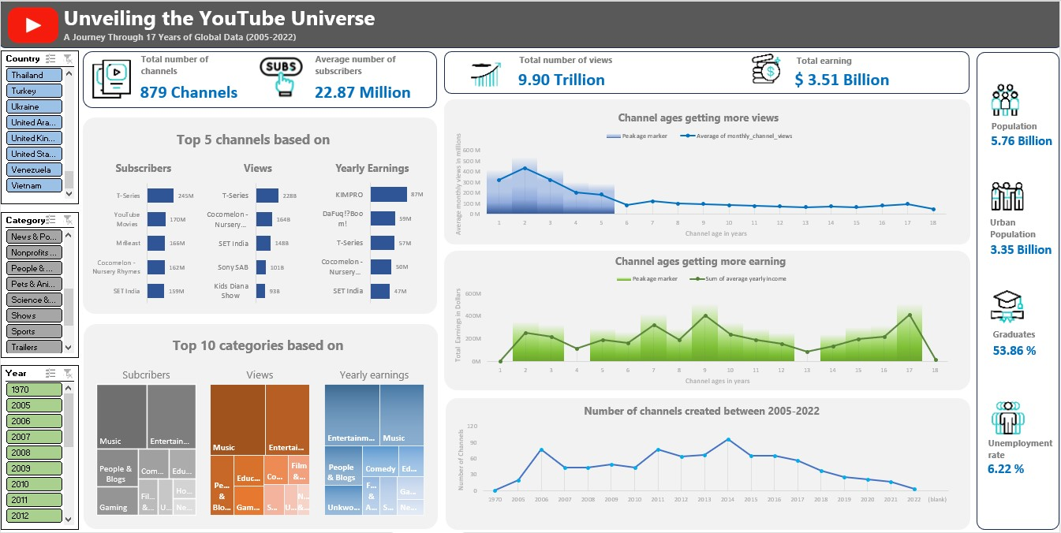

Slide 2

Insights on Views:
Channels that stay current with trends, memes, and popular culture often attract a wider audience. That’s why channel ages(relatively new content creators) ranging from 1-5 years get more views.
Successful channels often cover a wide range of content verticals, appealing to diverse audience interests. Music & Entertainment Channels like T-series, Set India, Sab India are some prime examples.
Only American and Indian content creators together managed to attract 58% of the global audience in terms of the last-30-days views count.

Slide 3
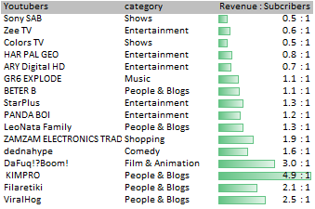
Insights on Subscribers:
Subscriber Count is not as important a metric as the Views, but it gives an idea about the channel's viewer retention.
Higher subscriber count does not always ensure that the views will be high, or the revenue generated will be high. If we benchmark T-series as a channel with decent revenue to subscriber ratio (0.24:1) then there is a list of channels whose subscriber count is not even half of T-series but generates revenue which is more than or equal to 50% of the revenue of T-series.

Slide 4
Insights on Earnings:
Diversified revenue streams, including ads, sponsorships, merchandise, and memberships, are common among top channels. Therefore, earnings of channels not only dependent on time but also dependent on views, brand management, niche of content etc. It is seen that each Category behaved differently in terms of monetizing their content through ads only.
Viewers like to watch content of channels from categories like Auto & Vehicles, Shopping, Science & Technology when they are repute and famous.
Channels from categories like Entertainment, Comedy, Shows, Gaming and Music earn more when they are relatively ,new and have fresh content for audiences.
Categories like People &Vlogging take a considerable time to build connection with viewers hence they earn more when they are at least 4-5 years old.
2) American and Indian youtubers earns 56% of the Global Revenue.

Slide 5


Thank You
Please Follow
For more Such Projects
LinkedIn

